Slide 1
BINAR FSW WAVE 32
CHALLENGE 7 – AGNES SEPTILIA
API ARCHITECTURE

Slide 2
PREPARATION

Slide 3
INSTALLATION
ACTIONS | DESCRIPTION | CHECKLIST
Initiate workspace using boiler plate | npm install -g express-generator npx express --view ejs --git fsw_ch07 | 
Install dependencies | npm install (to install existing dependencies) npm install crypto-js formidable jquery jsdom pg pg-hstore sequelize jsonwebtoken npm install dotenv-load --save-dev nodemon --save-dev | 
Create environment file | .env file | 
Create database | Table is created on postgresql database using sql/create_table.sql Sequelize initiation is done manual through config/index.js | 
Connection to server | Test connection to local server through port | 
Generate credentials for Superadmin | Sign up as Superadmin Get the encrypted password on database to put on .env file Run generateAdminToken.js file to generate the Superadmin token Note: the uncrypted password on env is only for reference. Direct encryption might produce different outcome with the one that goes through web | 

Slide 4
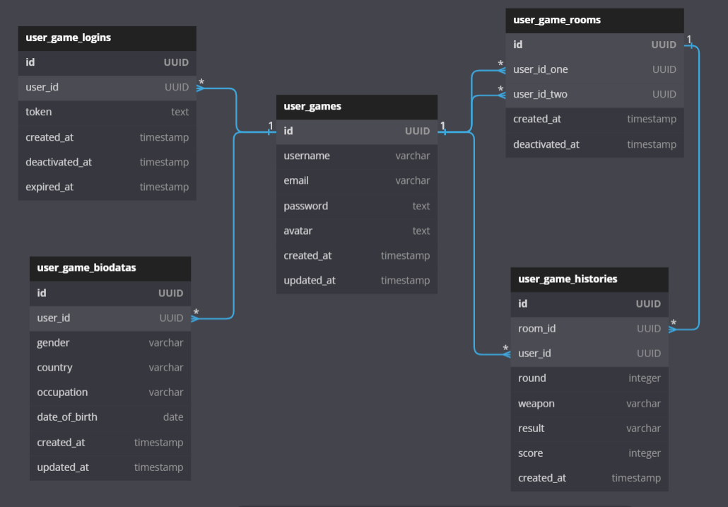
DATABASE

Slide 5
REGISTRATION

Slide 6
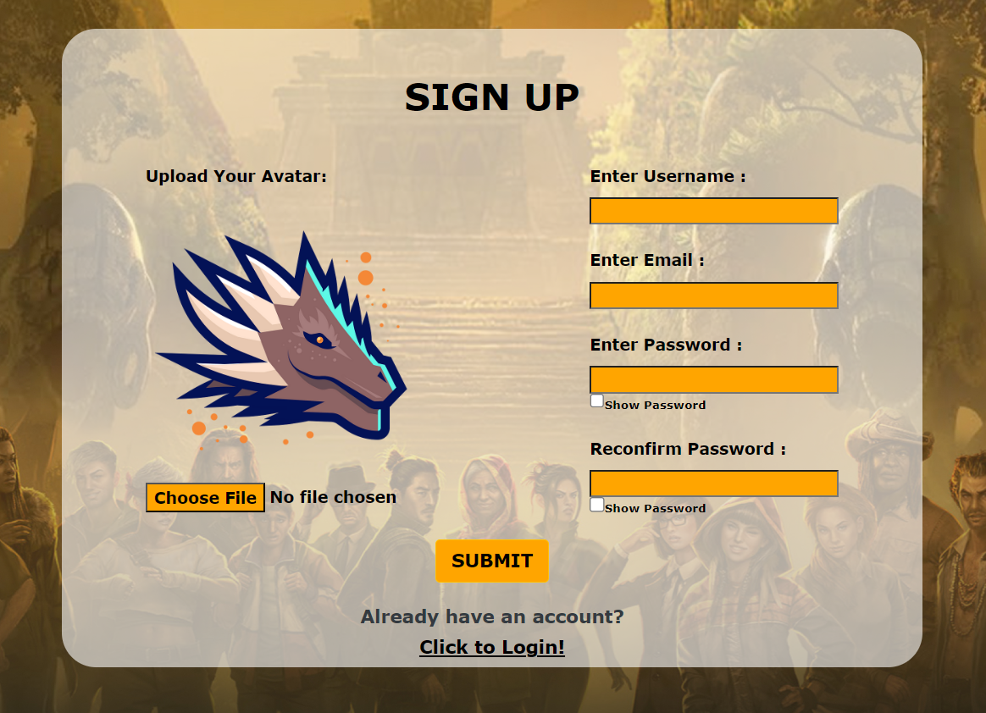
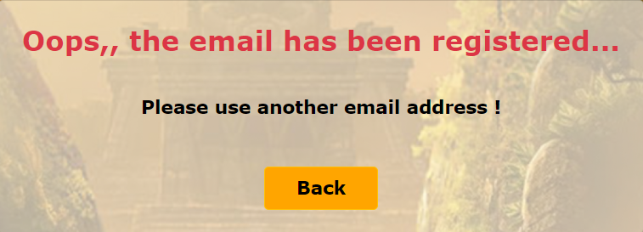
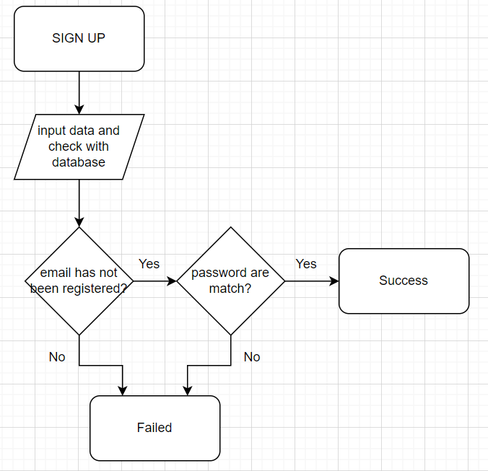
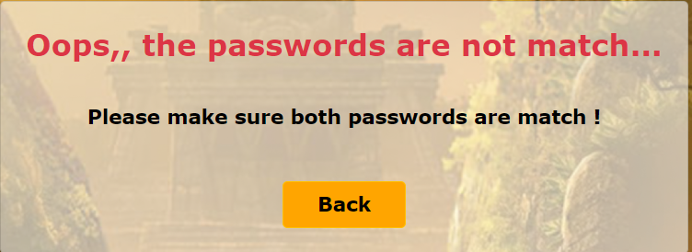
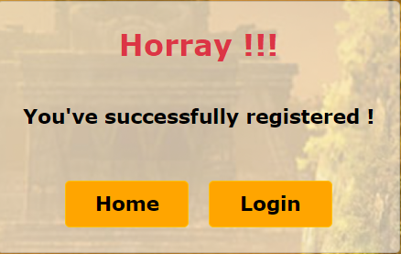
REGISTRATION : SIGN UP
Password will be encrypted before being saved to database
Sign up data will be saved to user_games table

Slide 7
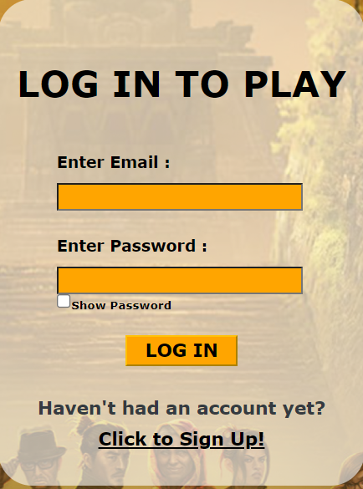
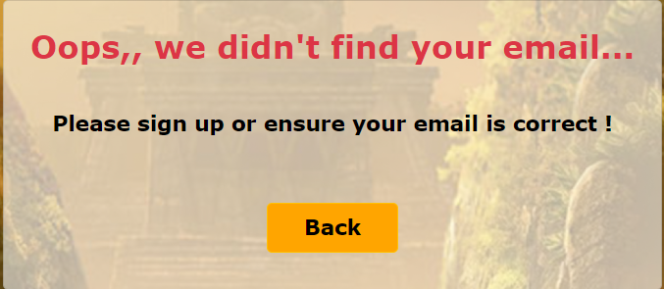
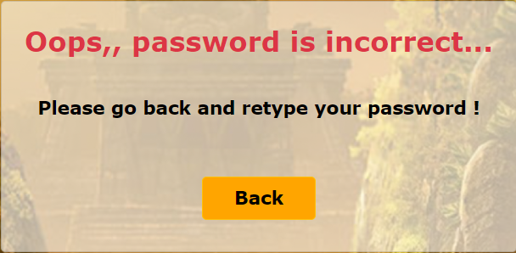
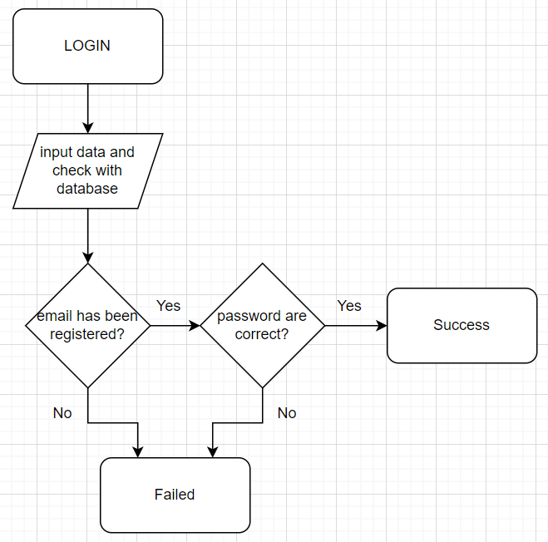

REGISTRATION : LOGIN
Login will create token that will be active until user logout
Login and token data will be saved to user_game_logins table

Slide 8
USER PROFILE

Slide 9
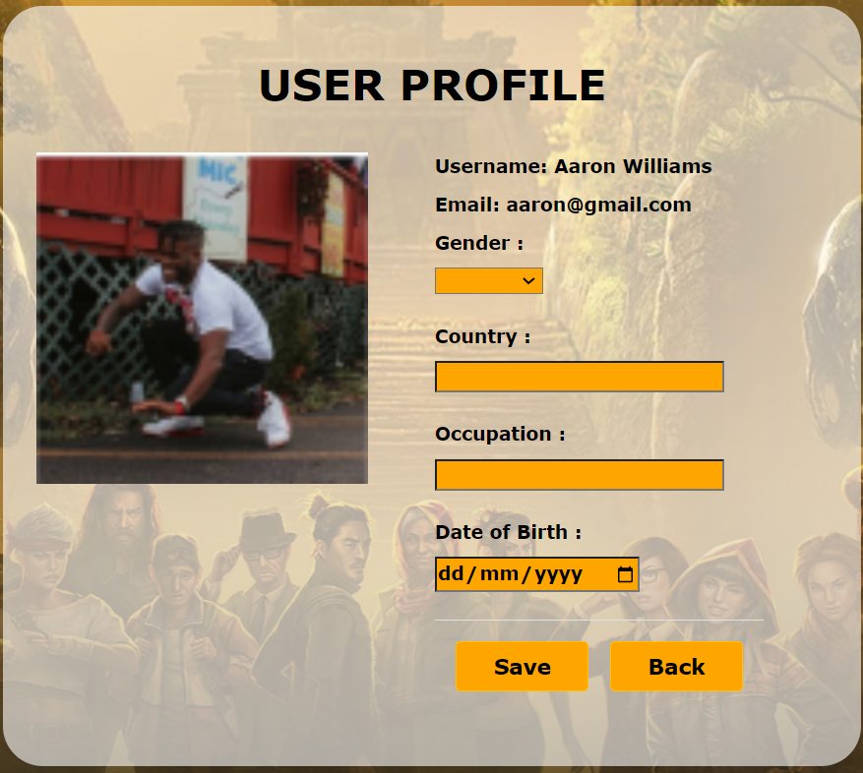


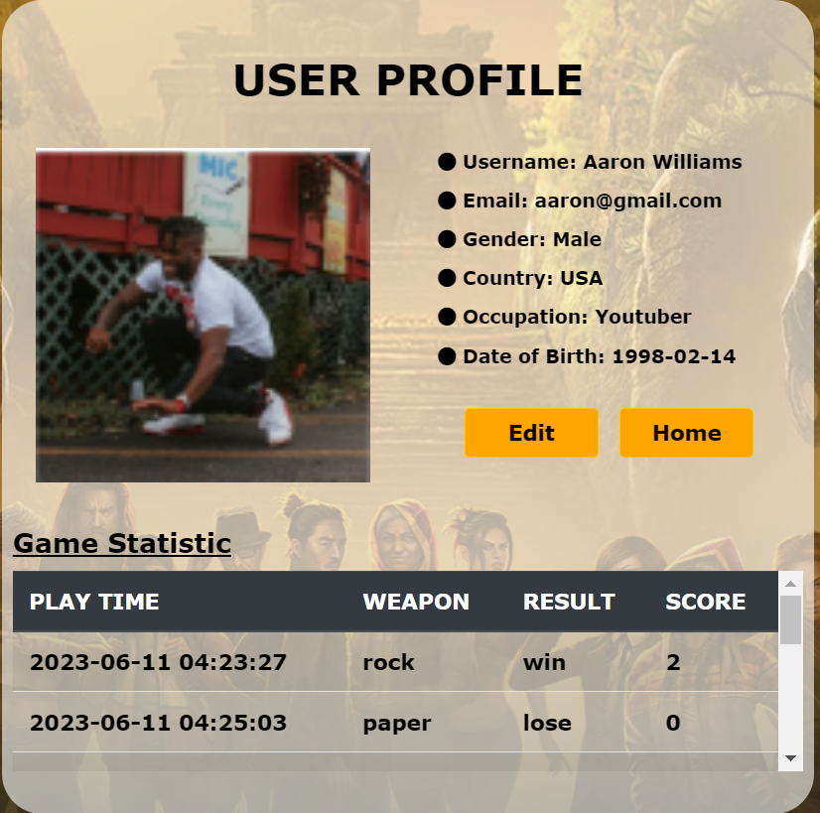
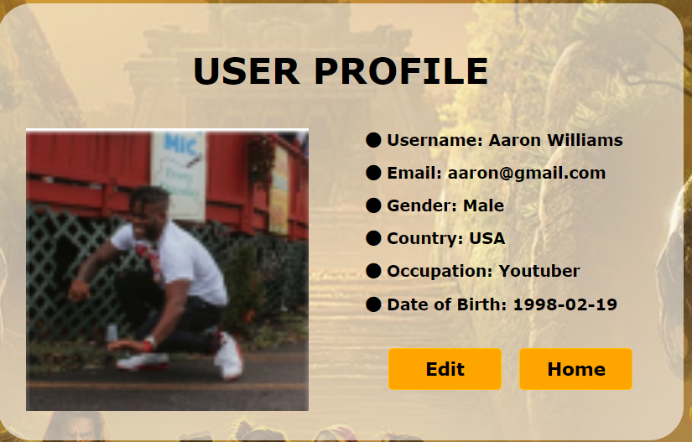
USER PROFILE
User Profile is accessible after user login.
User can only update for their biodata.
New or updated data will be saved on user_game_biodatas table.
User Profile view also saves game history data

Slide 10
THE GAME

Slide 11

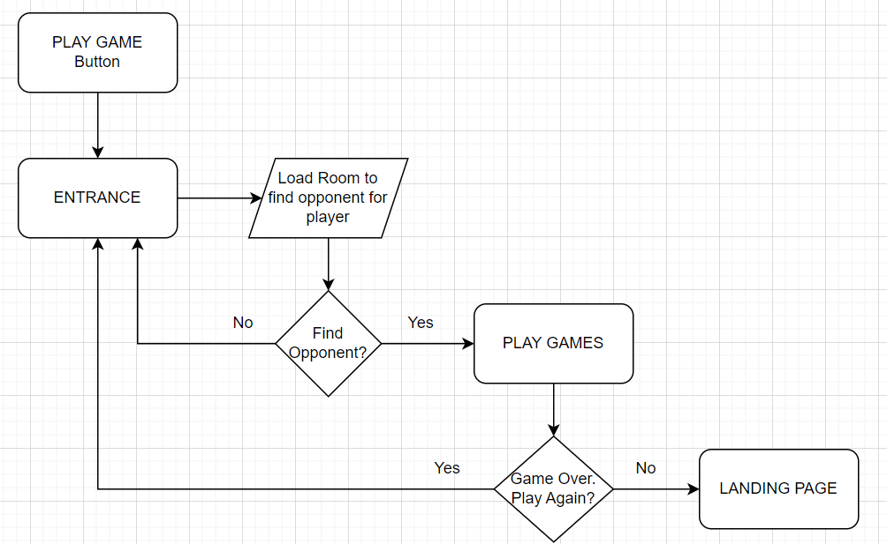
THE GAMES: LOADING ROOM
The game can be accessed through ‘PLAY NOW’ button on the landing page, or ‘Play Game’ button after user finish their login.
Only user with active token can enter the game. Otherwise, they will go to login page first.

Slide 12
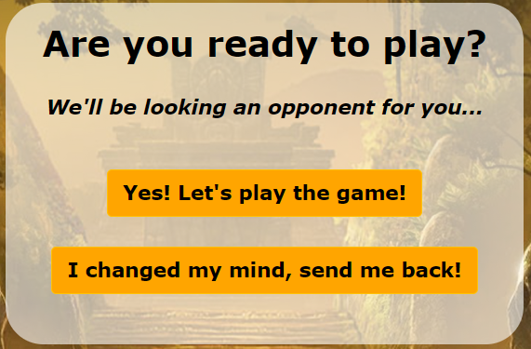
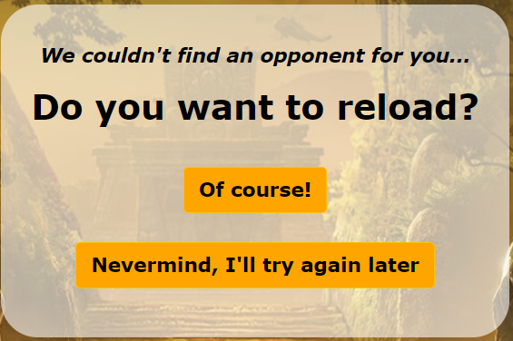
THE GAMES: LOADING ROOM
First Clarification
At first, user will have to confirm if they are ready to play.
The basic logic will be as follow:
User as Player 1
User confirms the First Clarification question.
If computer couldn’t find any empty room, user will initiate a room, be assigned as P1, and have to wait the opponent for around 1 minute.
If no opponent found until 1 minute, user will got the Second Clarification , whether to reload the process.
If opponent is found, then user enters the game as P1
Second Clarification
2. User as Player 2
User confirms the First Clarification.
If upon loading computer finds empty room created by others, user will directly enter game as P2. It might take a while for P1 to join the game as P1 need to wait another loop to get the information that the opponent is now available.

Slide 13
THE GAMES: LOADING ROOM
First Clarification
LIMITATION:
One loading process consists of 6 loops @ 10 seconds.
If both players confirm First Clarification almost at the same time, P2 will enter the game first, and P1 will enter the game 10 secs later
If P2 confirms First Clarification around 50secs after P1, P1 will not have enough time to notice the P2. P1 will get Second Clarification, and have to click ‘Of course!’ to reload the room and meet P2. However, if for example P2 has enter the room, but P1 decided not to reload the room, P2 will be leave hanging in the room without any opponent.
Best practice: Load room for P2 not more than 40sec after P1.
Second Clarification

Slide 14
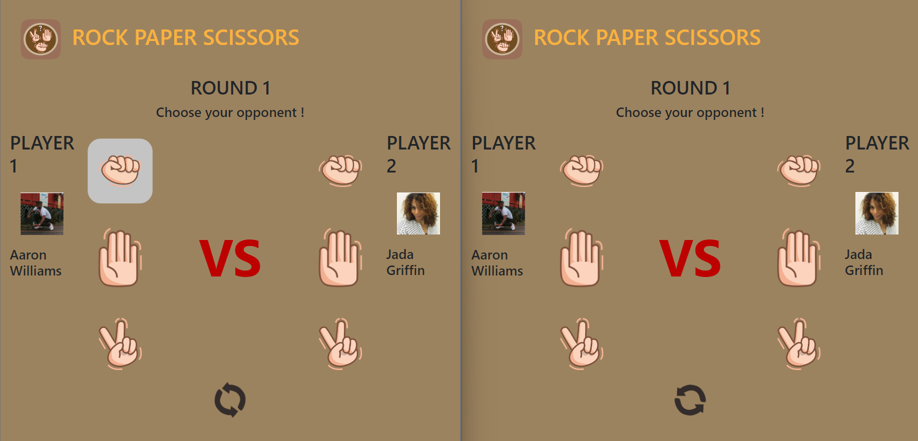
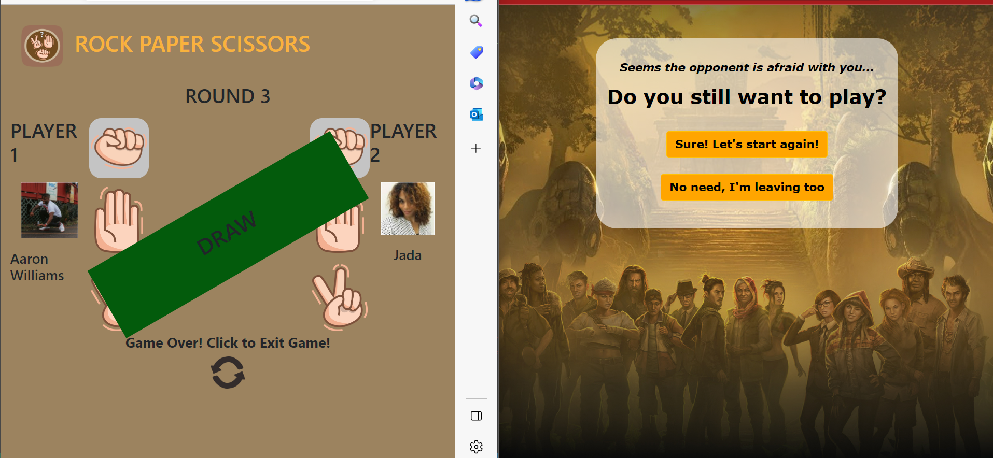
THE GAMES: CHOOSE WEAPON
Inside the game, any player will choose the weapon, and have to wait opponent to choose theirs within 1minute (12 loop @ 5 secs). The game will be continue once both weapons are submitted.
LIMITATION:
There is an issue though, if for example P2 submit the weapon first, and within 1min P1 didn’t submit their weapon. P2 will be redirect to the entrance and able to load another room, while P1 are still left in the room.
If later P1 choose their weapon, while P2 already left, P1 will still got the result and score.
Best Practice:
After one player choose the weapon, click the opponent’s weapon immediately.

Slide 15
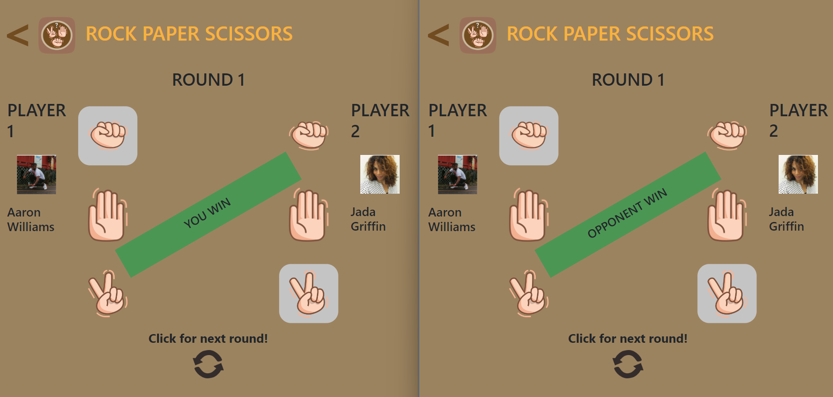

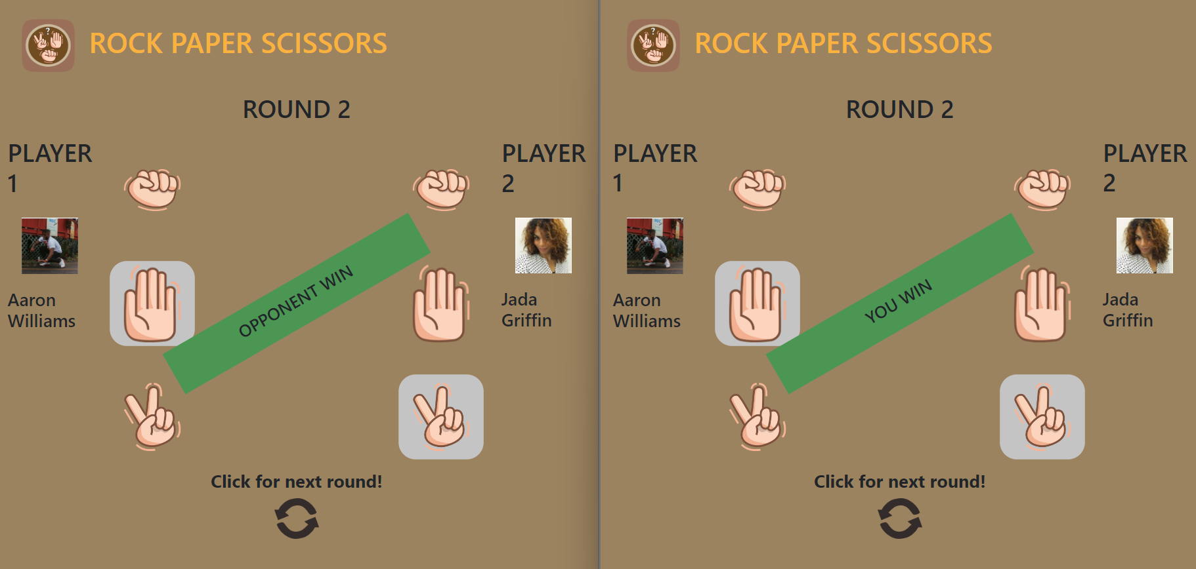
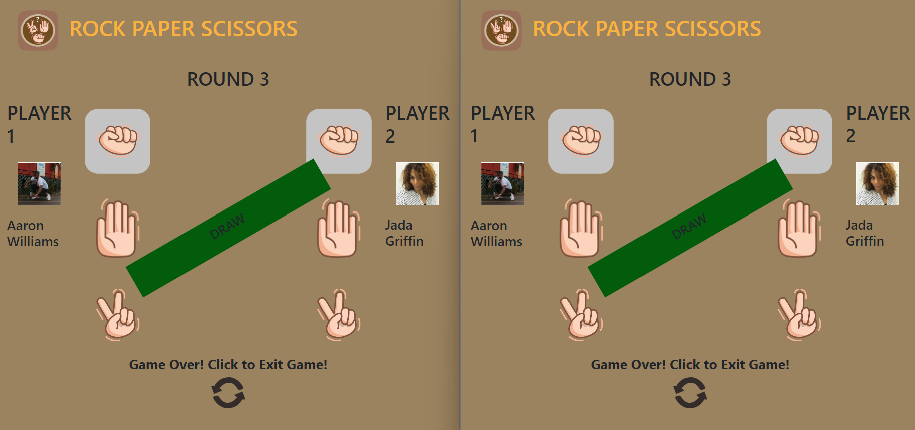
THE GAMES: RESULT PER ROUND
In normal flow of games, after both weapons submitted, player will get the result on each round.
Go to next round , or end the game (if round has up) by clicking the refresh button.
Total played: 3 rounds

Slide 16
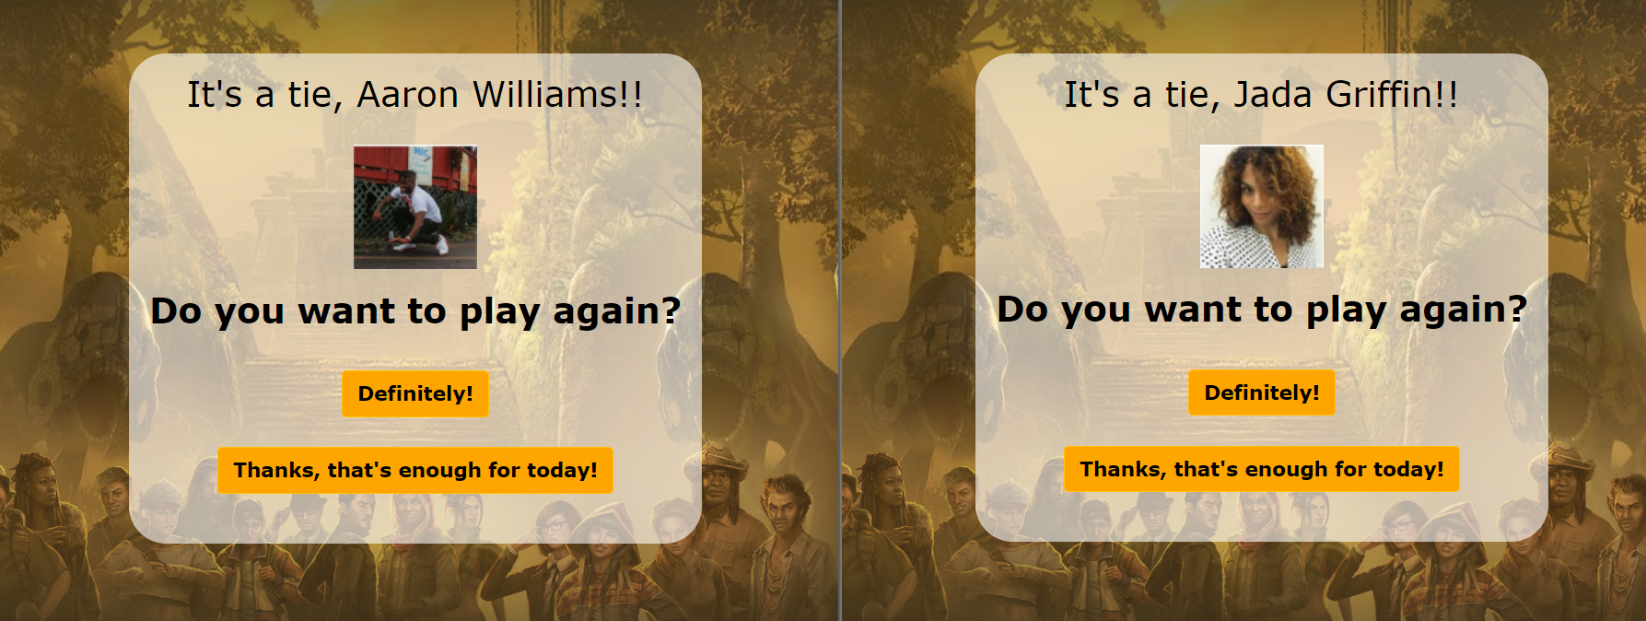
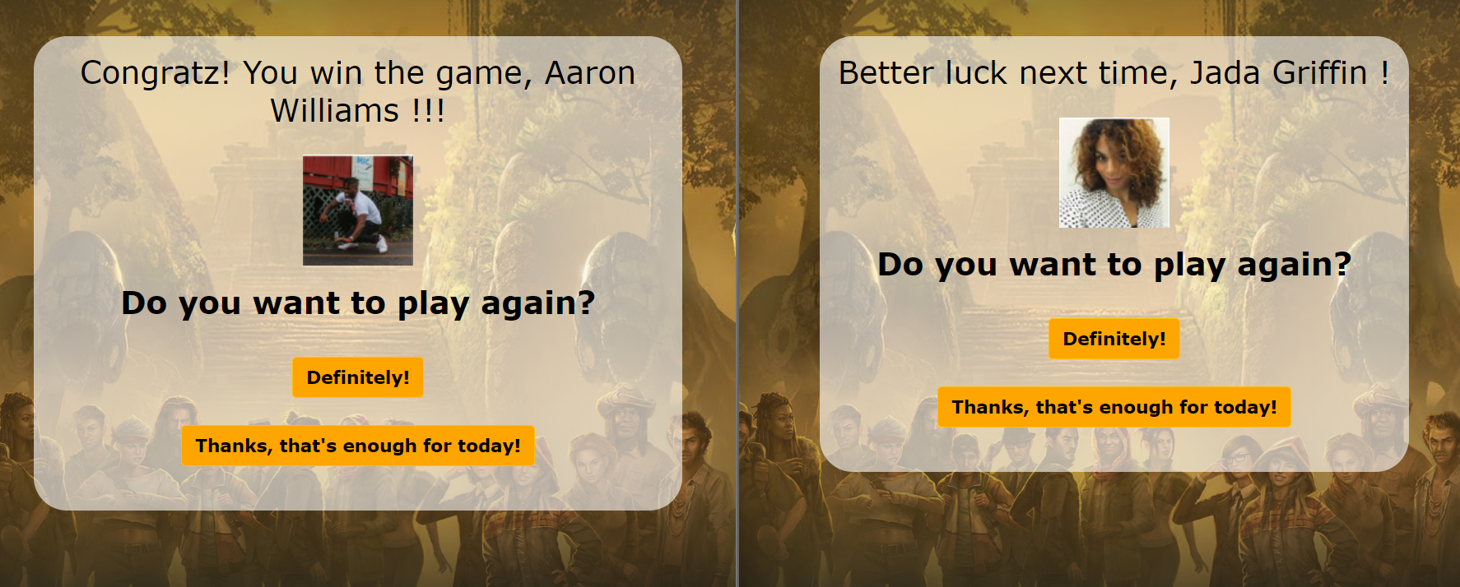
THE GAMES: GAME OVER
When game over, player will got summary of the game like these:
Draw
Winner - Loser

Slide 17
SUPER ADMIN

Slide 18
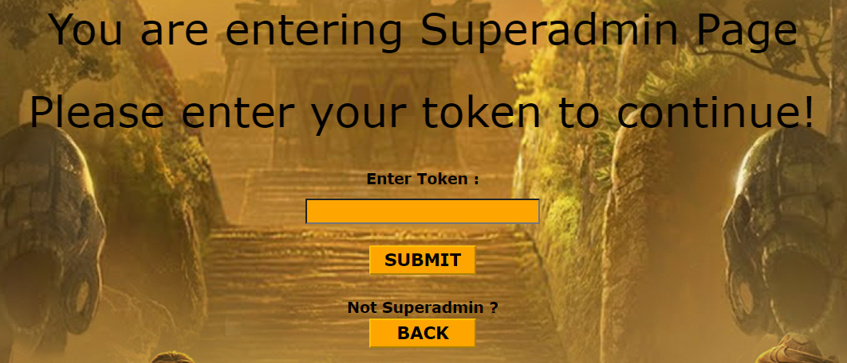
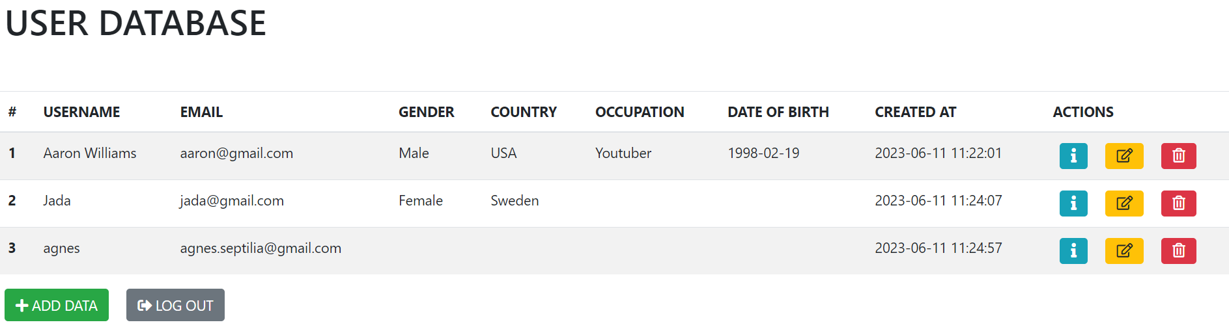
ADMIN DASHBOARD
To access Superadmin page, Login using Superadmin email and password
Then, there will be a page asking for credential token.
If the token is accepted, it will redirect to admin Dashboard page like below image.

Slide 19
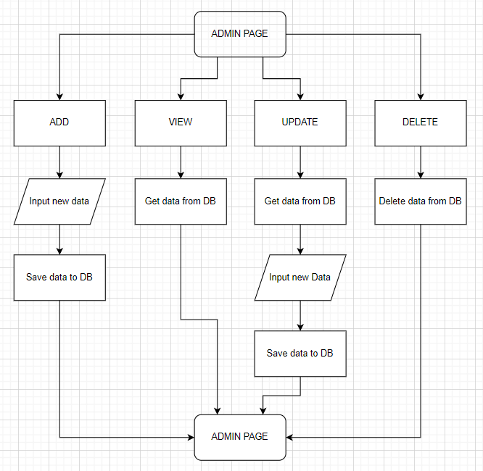
ADMIN DASHBOARD

Slide 20
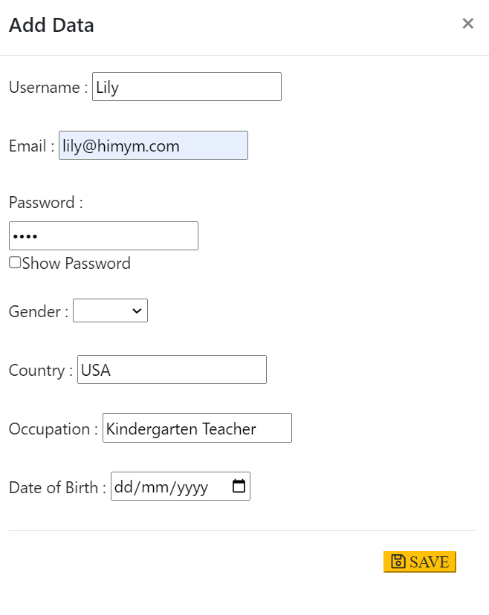
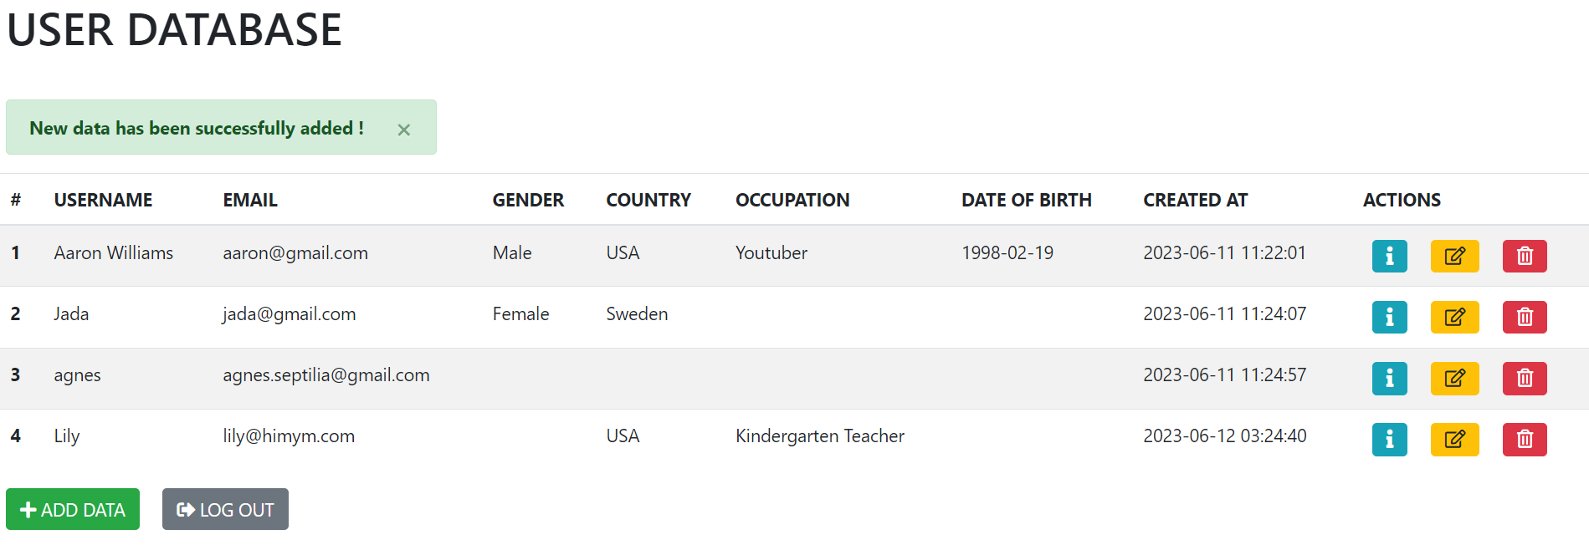
ADMIN DASHBOARD: ADD DATA
Add data will show a modal for user to fill the form.
Add data will fail if email has been registered previously.
Username, email, and password are mandatory.
Alert will show up when the data creating process is success.

Slide 21
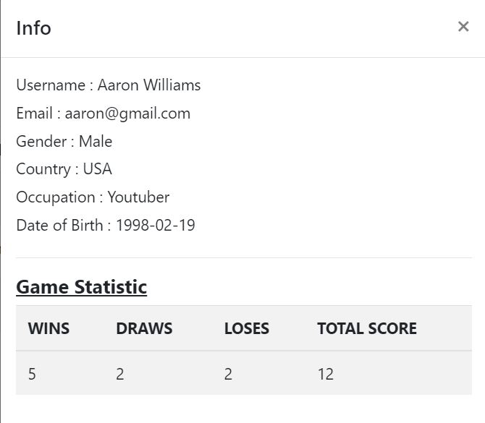
ADMIN DASHBOARD: VIEW DATA
Info Button will show a modal of user’s biodata, and also their game statistic.

Slide 22
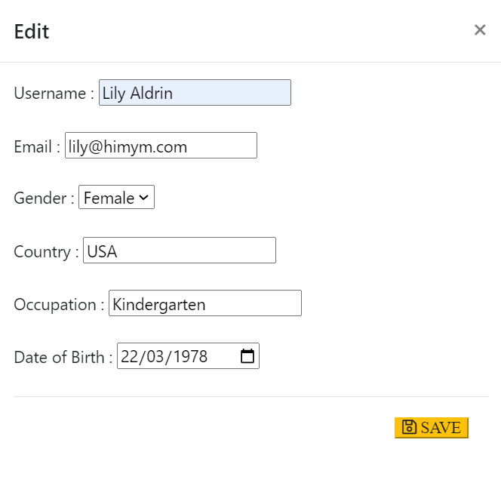
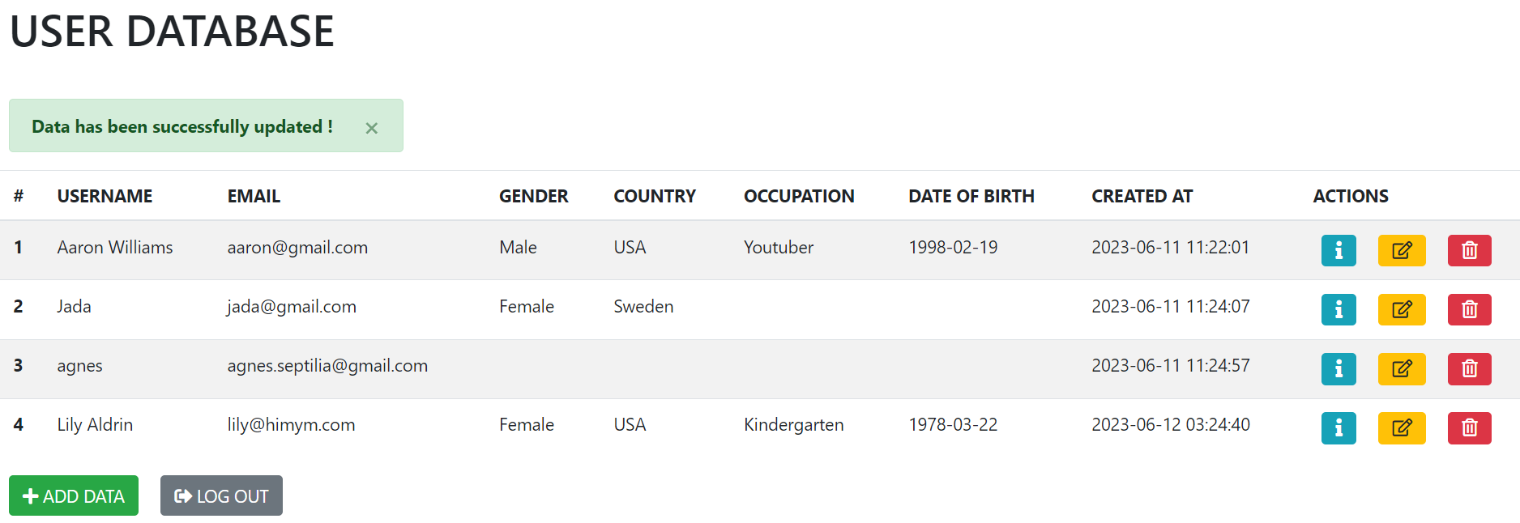
ADMIN DASHBOARD: UPDATE DATA
Edit Button will show a modal for user filling the form.
Updated data will be shown on dashboard with an alert marking its succeed

Slide 23
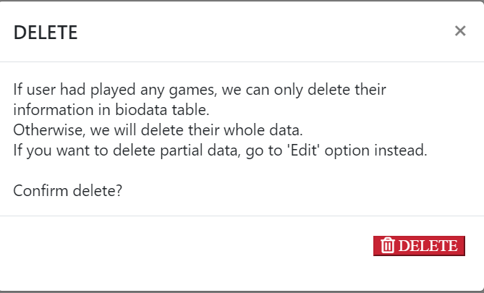
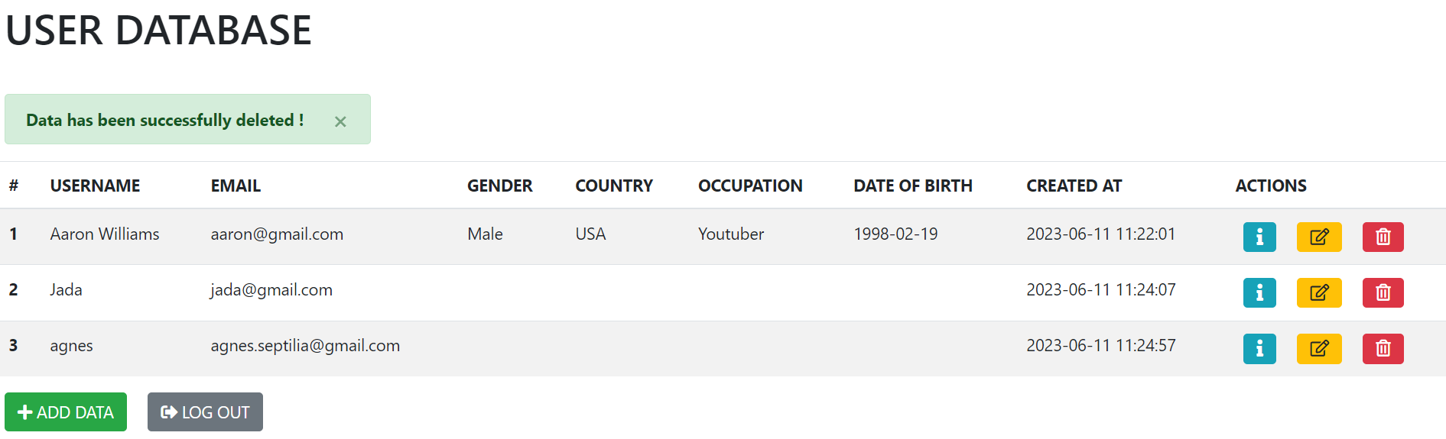
ADMIN DASHBOARD: DELETE DATA
Delete button will show a modal for asking user’s confirmation.
Due to it’s dependencies, if user had played any games, we only delete their biodata table.
But if they haven’t played any, we can delete their whole information. Example in Username#2: Jada, their data is still there, but the biodata is empty. But Username#4: Lily has completely removed.
An alert will be shown to mark its success

Slide 24
LOGOUT

Slide 25
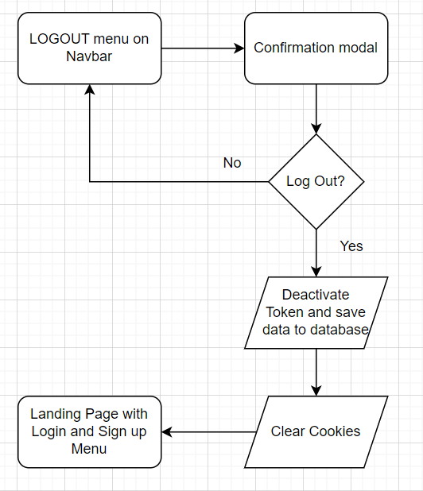
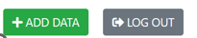
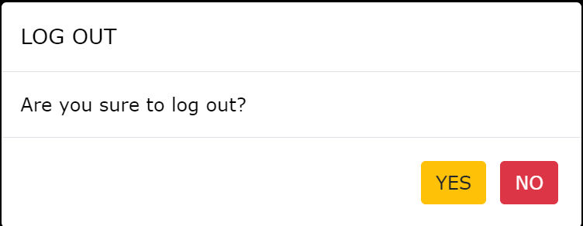
LOGOUT
LOGOUT
Superadmin Logout
User Logout
Logout Modal

Slide 26
CHALLENGE CHECKLIST

Slide 27
CHECKLIST
REQUEST | APPLICATION | CHECKLIST
Apply Design Pattern MVC & MRC and apply template engine | Already using Models, Views, Controllers, and Routers configuration | 
Apply Asynchronous process | Async-await is used for two process that have dependencies. setTimeout() is used if there two process that have dependencies, and give delay to ensure first process is completely done. setInterval() is used for looping process Sync process is used for two process that didn’t have dependencies | 
Authorization and Authentication | Applied using JWT token + cookies | 
Two players can join a room and play games | Works, but with several limitation of error handling | 
Players can see game result | Player can see the latest game result after game over, or see the historical list on Profile page | 

